Slide 1
Social and Professional Issues
John Louis D. Mercaral, MIS

Slide 2
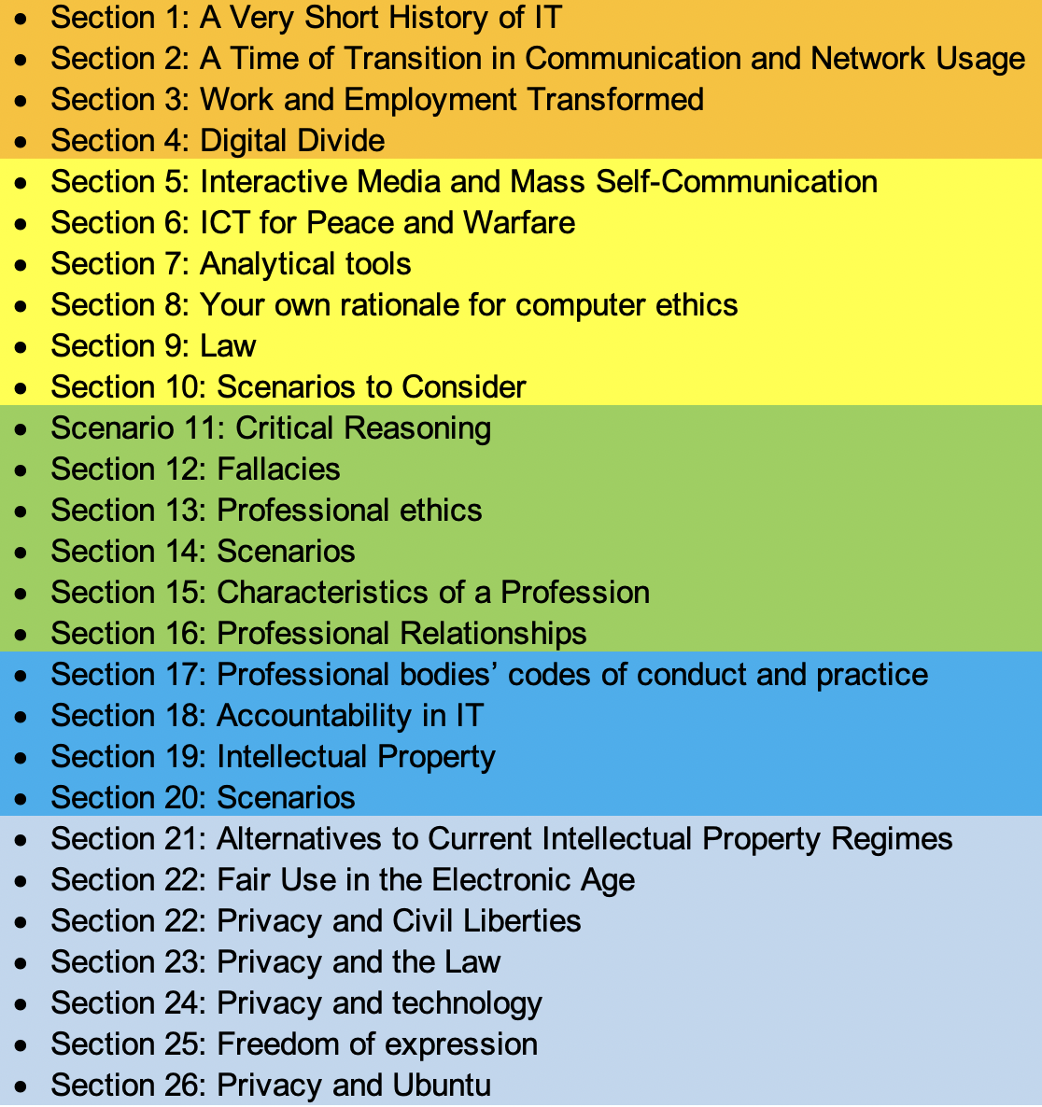

Topics Distribution

Slide 3
Possible Timeline
Group 1 – January 28
Group 2 – February 04
Prelim Examination – February 18
NO MIDTERM EXAM
Group 3 – April 08
Group 4 – April 15
Group 5 – April 22
Pre-Final Examination – May 06
NO FINAL EXAM

Slide 4
Any Questions?

Slide 5
Possible Timeline
Group 1 – January 28
Group 2 – February 04
Prelim Examination – February 18
NO MIDTERM EXAM
Group 3 – April 08
Group 4 – April 15
Group 5 – April 22
Pre-Final Examination – May 06
NO FINAL EXAM
Due to Capstone Title Defense
Due to Capstone Title Completion

Slide 6
Capstone Project 1
John Louis D. Mercaral, MIS

Slide 7
Introduction
This course represents the culmination of your academic training, providing a platform to demonstrate the knowledge, skills, and competencies you have acquired throughout your program. You will be expected to identify a real-world problem, conduct thorough research and analysis, and develop an innovative solution through a well-executed project. This experience aims to strengthen your ability to work independently or collaboratively, apply critical thinking, and communicate effectively in both written and oral forms. The Capstone Project is not only a measure of academic achievement but also a significant step toward professional readiness.

Slide 8
Course Intended Learning Outcomes
#1
#2
#3
Use systems analysis and design tools to analyze business processes and identify IT-based solutions for a capstone project.
Present and defend the proposed capstone project to different audiences.
Develop the approved capstone project by creating an initial system user interface prototype.

Slide 9
Capstone Project Composition
01
Project Manager
02
System Analyst & Technical Writer
03
System Designer
04
System Developer
The Capstone Project team consists of three to four members, each assigned specific roles and responsibilities regardless of enrollment size.
Oversees and leads the capstone project.
Coordinates the system and completes documentation.
Designs the database, network, and user interface.
Builds and tests the system programs.

Slide 10
Capstone Project Advisory Committee
The Program Head may assign a capstone adviser and panel members to ensure they are suitable for the project, forming the Project Advisory Committee.
Project Adviser
Panel Chairman
Panel Members (2)
a faculty member of the Institute, ensures academic standards, guides the team throughout project development, meets regularly with the group, and recommends the project for all defense stages.
the Program Head or Dean of the Institute, briefs the team on all defense stages and issues the final, unanimous verdict.
who may be faculty or non-faculty, evaluate the technical paper and system, recommend a verdict, and consider requests from the adviser and team.

Slide 11






Project Theme
Capstone projects focus on system development, where proponents must identify an organization’s specific needs and design a product that meets those demands. These projects can address real workplace problems. According to the CMO 25 series 2015, the BSIT Capstone must focus on emerging technologies but not limited to:
Geographic Information System (GIS)
Artificial Intelligence (AI)
Machine Learning (ML)
Image Processing
Facial Recognition
Internet of Things (IoT)

Slide 12
Project Theme
To set the difficulty level, Capstone Project instructors propose themes for faculty approval, though in exceptional cases approval may come from the Program Head.
Proponents must develop a unique system that differs from past projects, but the Institute may assign specific topics if requested by partner government agencies, provided they still align with the approved themes.
Project proposals that integrate two or more of the following concepts are more likely to receive approval: Geographic Information Systems (GIS), Artificial Intelligence (AI), Machine Learning, Image Processing, Facial Recognition, and the Internet of Things (IoT).

Slide 13

Capstone Roadmap
Deploy the
system
Final
Congrats!
Outline
Title
Finalize documentation and technical paper
Defend the final project and present results
Proposed Fee: ₱9,800.00
Develop the research and system design
Define the system: analysis, design, testing, implementation, and maintenance
Defend the outline to the panel
Proposed Fee: ₱5,500.00
Identify a real problem and choose a project theme
Produce a clear and specific project title
Get approval from adviser and panel
Proposed Fee: ₱4,600.00

Slide 14
01
Capstone Title
an essential component in every research

Slide 15
Capstone Title
The title is an essential component in every research proposal since it hints to readers whether they will read your paper or not. It should present readers with a clear and concise description of the entire project. The following are some pointers of how to construct a good title (Nair, 2014):
Contain as few words as possible: many journals limit tags from 12 to 15 words
Be easy to understand
Describe the contents of the paper accurately and specifically
Avoid abbreviations, formulas, and jargon
Not include any verb
Not contain low-impact words such as "Some notes on ...," "Observations on ...," "Investigations on ...," "Study of ...," and "Effect of ...")
Not be flashy as in newspapers (e.g., avoid statements like "Agroforestry can stop deforestation")
Report the subject of the research rather than the results

Slide 16
Capstone Title
The titles that will be approved on LCC should answer the following questions: What, Where, and How.
WHAT presents the description of the proposed system;
WHERE details the business profile of the selected organization/business firm that will serve as the project's primary stakeholder;
HOW (optional) presents to readers the technology/technologies used to develop the system.

Slide 17
Capstone Title
The following are sample titles of implemented capstone projects in the other higher education institutions:
RiceDoc: A Mobile-based Rice Leaf Disease Detection through Image Recognition of Rice Leaf Images using Convolutional Neural Network (Answers What And How)
Banana-Q: A Mobile Image Classification for Banana Classes Identification using Convolutional Neural Network (CNN) in Diamond Individual Farmers Cooperative (Answers What, How, Where)
Waterwise: A Smart Plant Watering System using IOT in the City Hall of Panabo (Answers What, Where, How)
LeafCheck: An Intelligent Crop Management System for Eggplant with Disease Identification, and Weather-based Yield Prediction (Answers What And How)

Slide 18
Title: Document Contents
Background of the Study
Objectives of the Study
Scope and Limitation
References

Slide 19
Title: Document Contents
Background of the Study
The background of the project presents the literature review of the project. Specifically, the background of the project defines the nature and extent of the problems studied, relates the research to previous work (usually by a brief review of the literature relevant to the problem), explains the objectives of the investigation, and defines any specialized terms or abbreviations to be used in what follows [1].
Remember that the project's background leads logically too, and clearly states, the hypothesis or principal theme of the paper.

Slide 20
Title: Document Contents
Background of the Study
The following are the recommended contents of the background of the project section (note: you may not follow this recommendation, it’s up to you how you will organize your contents as long as you present a detailed literature review of the project/system):
Introductory statement
Rationale of the study (global, national, and local view of point)
Locale of the study and problems
CHED-ACHIEVE framework alignment

Slide 21
Background of the Study
Introductory Statement
This section introduces the main topic of the capstone project. It sets the context and provides background information about the problem area. The introductory statement should briefly explain what the study is about and why it is important. It should capture the reader’s attention and give an overview of the issues that the project aims to address.
Rationale of the Study (Global, National, and Local View)
This part explains the reason for conducting the study by describing its relevance and significance at different levels:
Global View: Explains how the problem affects people worldwide and highlights global trends or challenges related to the topic.
National View: Shows how the issue impacts the country and refers to national statistics, policies, or programs.
Local View: Focuses on the specific city, location, community or organization where the study is conducted and explains why the project is needed there.

Slide 22
Background of the Study
Locale of the Study and Problems
This section describes where the study will be conducted and identifies the specific issues or challenges faced in that location. It includes:
Description of the organization or community involved, include (organization chart if company)
Background information about the locale
Specific problems or gaps that the study aims to solve
How the project will address those problems

Slide 23
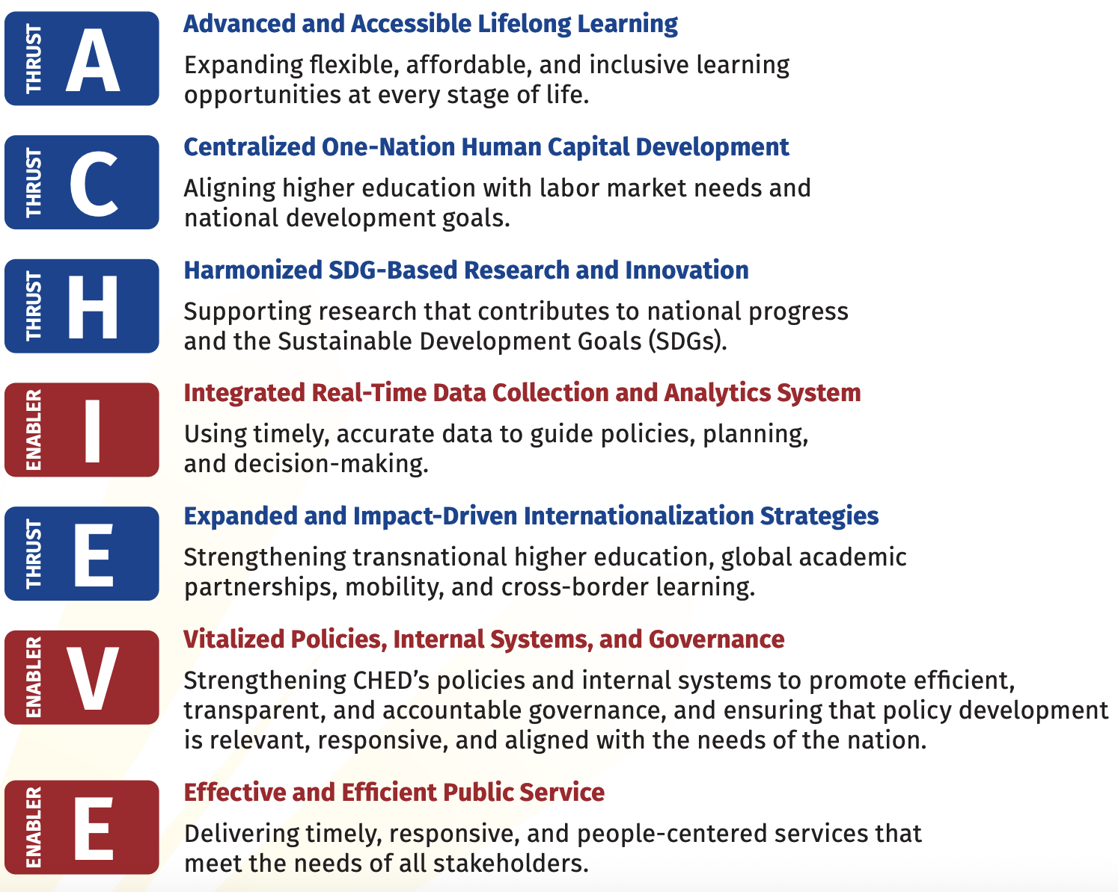

Background of the Study
CHED-ACHIEVE Framework Alignment
This part aligns the project with the CHED-ACHIEVE framework. It shows how the project contributes to the standards and goals of the Commission on Higher Education (CHED) for higher education quality and excellence.
You must connect your project to relevant CHED outcomes such as:
Explain how your project supports these goals and contributes to the educational mission.

Slide 24
Title: Document Contents
Objectives of the Study
The study's objectives state what the proponents expect to achieve in general terms and outline the exact details of the project. Each objective should answer all the business problems as cited in the introduction.
An objective should start with an action verb and be constructed in SMART format (Specific, Measurable, Attainable/Achievable, Realistic/Relevant, and Time-Oriented). Arrange the specific objectives in an IPO (Input Process-Output) manner.

Slide 25
Title: Document Contents
Objectives of the Study
Sample (Please be creative and construct your objective):
This study aims to develop an Android application capable of detecting rice diseases using the rice plant’s leaves. Specifically, it refers to:
1. Identify the following rice leaf diseases using DenseNet121 Convolutional Neural Network architecture:
1.1 Rice Leaf Blast

Slide 26
Title: Document Contents
Scope and Limitation
The scope of the study discusses the study's inclusions and coverage, which include, but are not limited to,
(1) the possible location of deployment,
(2) potential users of the system, and
(3) an overview of the processes involved.
The discussion of the scope should be limited to one paragraph.

Slide 27
Title: Document Contents
Scope and Limitation
The limitations are exclusions from the study that were beyond the developers' control, which include but are not limited to
(1) processes involving or related to the system that is excluded in the development,
(2) technology limitation (i.e., data mining or machine learning features limitation, GIS functionality limitation, game design constraints),
(3) platform to be used (web-based, windows-based, online or offline),

Slide 28
Title: Document Contents
Scope and Limitation
(4) type of data to be used in the study, and
(5) non-functional requirements. Non-functional requirements are descriptions of the system's operation capabilities and limits that improve its functionality. These can include things like speed, security, and dependability.

Slide 29
Title: Document Contents
Reference
In this capstone project, the IEEE formatting style will be used for writing and documenting the research and system development. IEEE is a widely accepted standard in engineering and technology fields, making the capstone paper more professional and aligned with academic requirements.
Sample:
[1] P. K. Nair and V. Nair, Scientific Writing and Communication in Agriculture and Natural Resources, Springer International Publishing, 2014.

Slide 30
Styling Format
HEADING (Main Header; Centered; Bold; ALL CAPS)
Subheading (Left Align, Bold)
Font: Arial, 12, double spacing
All contents of the section should be in paragraph form (justified with special indentation 0.5 at the first line)
Margins: (Left: 1.5 Inches, top: 1 Inch, right: 1 Inch, and bottom: 1 Inch)
Follow IEEE format in citing references .

Slide 31
Title Checklist
Select Community or Organization
Choose a community, agency, or organization to study
Submit accomplished Environmental Scanning
Identify their needs or problems that require a system solution
Identify Problem or Need
Analyze current processes and identify gaps
Determine how IT can solve the problem
Choose Project Theme
Select an appropriate theme (AI, IoT, GIS, etc.)
Ensure it is innovative and feasible

Slide 32
Title Checklist
Conduct Preliminary Research
Review related studies and existing systems
Identify gaps and opportunities for improvement
Finalize Possible Title
Write multiple title options
Ensure titles are clear, specific, and aligned with the project
Refine the final title
Complete the Title Document
Fill out the required title proposal document
Review and verify all details before submission

Slide 33
Title Checklist
Adviser Endorsement
Present the final title to the adviser
Obtain endorsement or the Recommendation for Title Defense
Payment and Schedule
Pay the required fees
Attain the title defense schedule
Title Defense
Prepare title defense presentation
Present the title to the panel
Receive approval and feedback
Collect the Feedback and list it on Minutes of the Meeting

Slide 34

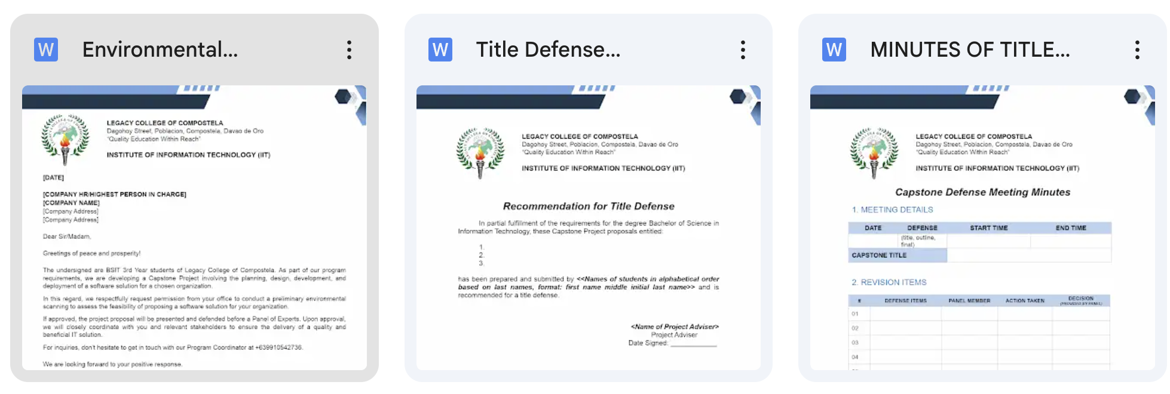
Sample Format and Other Documents

Slide 35
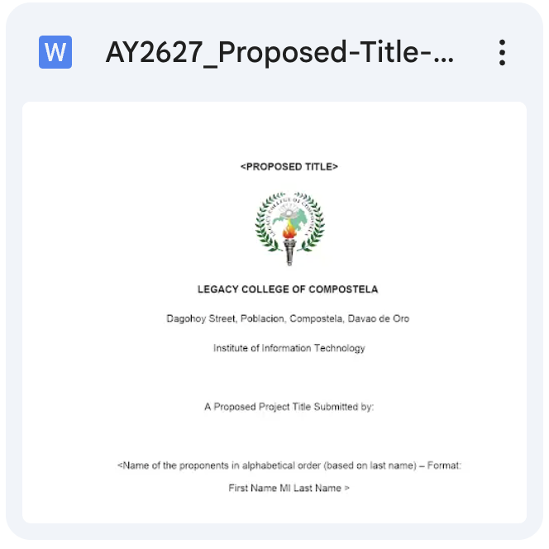

Sample Format and Other Documents

Slide 36
Next Action
Form a group with 3-4 Members
Produce 3 Project Titles
Adviser Pool:
Kyle Pacatang (Expertise: Image Processing, AI, ML, IOT)
Lorjohn Raña (Expertise: Image Processing, Facial Recognition, IOT, ML)
Howard Glen Gloria (Expertise: Image Processing, Facial Recognition, ML)
Jonard Tanilon (Expertise: GIS)
Complete the Title Checklist
Title Defense Tentative Schedule: March 21, 2026 (Saturday)
Outline Defense Tentative Schedule : June 19-20, 2026

Slide 37
Any Questions?

